Slide 1
Developing Advanced Microsoft ASP.NET Web Applications (C# 4)
Day #1

Slide 2
Overview
Introduction
This 3 day course provides you with the skills and knowledge required to advance your .NET development skills to the next level, which you can use in your daily work to provide robust and high performing applications.
Student Prerequisites
To benefit from this course, you must be familiar with Microsoft Visual Studio and Microsoft ASP.NET. You should also have knowledge of basic relational database concepts and querying data by using Transact-SQL
Notes:
5

Slide 3
Overview
Objectives
At the end of the course, you will be able to understand how to program better and to implement
Ajax/jQuery
Generics
Custom Controls
Linq to SQL
Extensions
Delegates
Notes:
5
During this course, I may implement some new codes which have yet to be taught, just follow along and I will revisit them later on during the course

Slide 4
Questions and Answers for .NET
Do you have any questions or problems with your actual work?
Anything which you have been trying to solve for a long time but you can’t seem to find a solution?
Email me at t@nus.edu.sg with the subject “.NET Questions” and I will try my best to answer them during the course.
Notes:
5

Slide 5
Outline
Day 1
Ajax in your web application
What is AJAX
Available ASP.NET AJAX Controls
jQuery
Lab: Creating an AJAX enabled website using both ASP.NET Ajax Controls and jQuery
Ajax Control Toolkit
Notes:
The training starts at 9 and ends at 5pm.
We are going to take it nice and slow for day 1, let everyone warm up first before tackling the harder topics. Going to keep it casual, so if you have any questions, just ask. You are here to learn to make the best use of it

Slide 6
Outline
Day 2
Generics and Custom Controls
Overview of Generics
Overview of Custom Control
Lab: Creating an custom control
LINQ To SQL
Overview of LINQ to SQL
Creating a LINQ TO SQL Relation
Working with LINQ To SQL Files
Lab: Creating a data aware web application
Notes:
On day 2, we will tackle the more tricky topics of generics, custom controls and the new LINQ to SQL
And on day 3, I will teach you how to program better, and avoid bad and inefficient codes

Slide 7
Outline
Day 3
Performance Programming
Overview of potential loopholes in ASP.NET Development
Looking at how to program better and faster
Lab: Optimizing your web application
Delegates and Extensions
What a delegate does
What are extensions
Lab: Using delegates and extensions in your code
Notes:
On day 2, we will tackle the more tricky topics of generics, custom controls and the new LINQ to SQL
And on day 3, I will teach you how to program better, and avoid bad and inefficient codes

Slide 8
Useful Resources
ASP.NET Forum: http://forums.asp.net/
ASP.NET Website: http://www.asp.net/

Slide 9
#1: Enabling Ajax in your web application – What is Ajax?
Ajax (shorthand for Asynchronous Javascript and XML) allows web applications to retrieve data from the web server in the background without disrupting the user when they are using the application.

Slide 10
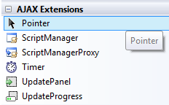
#1: Enabling Ajax in your web application – Overview of ASP.NET Ajax Controls
Microsoft.NET comes with a few built in controls
ScriptManager: The ScriptManager control manages client script for Microsoft ASP.NET AJAX pages. Required for all pages which contains ASP.NET Ajax controls
ScriptManagerProxy: Allows you to make changes to a scriptmanager located in a parent page e.g masterpages
UpdatePanel: UpdatePanel controls enable you to build rich, client-centric Web applications
UpdateProgress: UpdateProgress gives you the ability to display something on the web application to let your clients know something is happening
Timer: Performs asynchronous or synchronous Web page postbacks at a defined interval

Slide 11
#1: Enabling Ajax in your web application – What is Ajax?
Demo #1: Before and After Ajax
This demo aims to demonstrate the power of ajax and how it improves interactivity and reduces user disruption
http://localhost:12345/Chapter1/Demo/before.aspx

Slide 12
#1: Enabling Ajax in your web application – jQuery
ASP.NET Ajax libraries are good, users get the ajax effect and developers do not need to change their codes.
But this comes with certain performance penalties both on the client and on the server.
Notes:
Show before and after, what has been added and how easy it is to change a non ajax page to ajax page

Slide 13
#1: Enabling Ajax in your web application – jQuery
With ASP.NET 4, jQuery is now the preferred way to develop Ajax apps rather than using ASP.NET Ajax controls
However this is not as easy as using server controls. But it gives you more flexibility and control over how data is transferred between the client and the server
Notes:
Show before and after, what has been added and how easy it is to change a non ajax page to ajax page

Slide 14
#1: Enabling Ajax in your web application – Comparison
 | ASP.NET Ajax Library | jQuery
Usage | Server controls, drag and drop | Pure javascript
Debugging | Client and server side debugging | Client side debugging
Add Ons | Ajax ControlToolKits, 3rd party libraries from codeplex | Many
Javascript size | ~140K | ~90K
Payload | Large, especially with viewstate enabled | Depending on data being sent, usually extremely small

Slide 15
#1: Enabling Ajax in your web application - jQuery
This demo shows the jquery version of the previous demo. Although visually the same, there is now a lot lesser data being transferred.
This however comes at the expense of ease of development and debugging
http://localhost:12345/Chapter1/Demo/jquery/jquery.aspx

Slide 16
#1: Lab: Introducing Ajax to your web application
Your first day on the job, time to start shining!
Lab Specifications:
D:\Advanced ASP.NET\Lab\Lab1.docx
Notes:
Distribute the lab notes

Slide 17
#2: Ajax Control Toolkit
Ajax Control Toolkit
Overview of ASP.NET AJAX Control Toolkit
Explore each component in the control tool kit
Lab: Using Ajax Control Toolkit in your web application

Slide 18
#2: Ajax Control Toolkit
Ajax Control Toolkit
Open Source project to build controls that can be used out of the box to create an interactive web experience
Explore each component in the control tool kit
http://courses.nus.edu.sg/course/cittka/training/ajaxctk/

Slide 19
#2: Lab: Introducing Ajax Control Toolkit controls to your web application
Good job on your first assignment!
Its time for your 2nd assignment, and this time there’s no more hand holding
Lab Specifications:
D:\Advanced ASP.NET\Lab\Lab2.docx

Slide 20
Day 1: Summary
Ajax Controls
jQuery
Ajax Control ToolKit

Slide 21
Developing Advanced Microsoft ASP.NET Web Applications (C#)
Day #2

Slide 22
Outline
Day 2
Generics and Custom Controls
Overview of Generics
Overview of Custom Control
Lab: Creating an custom control
LINQ To SQL
Overview of LINQ to SQL
Creating a LINQ TO SQL Relation
Working with LINQ To SQL Files
Lab: Creating a data aware web application
Notes:
On day 2, we will tackle the more tricky topics of generics, custom controls and the new LINQ to SQL
And on day 3, I will teach you how to program better, and avoid bad and inefficient codes

Slide 23
#3: Generics and Custom Controls
Generics and Custom Controls
Overview of Generics
Overview of Custom Control
Lab: Creating an custom control

Slide 24
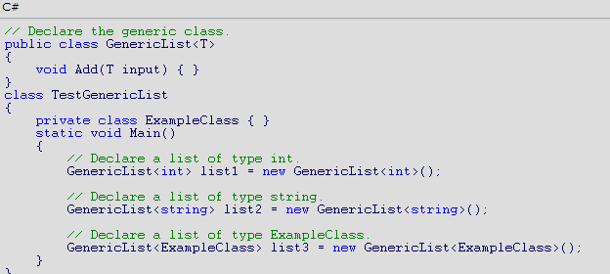
#3: Generics
http://msdn.microsoft.com/en-us/library/512aeb7t.aspx
Generics introduce to the .NET Framework the concept of type parameters, which make it possible to design classes and methods that defer the specification of one or more types until the class or method is declared and instantiated by client code.

Slide 25
#3: Generics
System.Collections.Generic Namespace
In .NET there are several classes which allows you to store collections and perform various operations on them, e.g ArrayList, Queue, Stack, HashTable.
However they perform slowly during boxing and unboxing operations (converting the class to an object type and the reverse operation)
So new generics controls are implemented which do not suffer from this problem
Dictionary<Tkey, Tvalue>, HashSet<T>, LinkedList<T>, Queue<T>, SortedDictionary<Tkey, Tvalue>, Stack<T>

Slide 26
#3: Generics– Definition and Usage
Definition | Usage
HashSet<T> Stores a list of values | var oHashSet = new HashSet<int>(); oHashSet.Add(1); oHashSet.Contains(1);
LinkedList<T>: A doubly linked list | var oList = new List<int>(); oList.Add(1); oList.Contains(1);
Queue<T>: Replacement for Queue | var oQueue = new Queue<int>(); oQueue.Enqueue(1); if (oQueue.Contains(1)){} oQueue.Dequeue();
Stack<T> Replacement for Stack | var oStack = new Stack<int>(); oStack.Push(1); if (oStack.Contains(1)){} oStack.Pop();

Slide 27
#3: Generics– Definition and Usage
Definition | Usage
Dictionary<Tkey, Tvalue> Replacement for HashTable No sorting is on the key | var oDictionary = new Dictionary<int, int>(); oDictionary.Add(1, 1); if (oDictionary.ContainsKey(1)){}
SortedDictionary<Tkey, Tvalue> A collection of key/value pair sorted by the key | var oSortedDictionary = new SortedDictionary<int, int>(); oSortedDictionary.Add(1, 1); if (oSortedDictionary.ContainsKey(1)){}

Slide 28
#3: Generics– Definition and Usage
Definition | Usage
HashSet<T> Stores a list of values | var oHashSet = new HashSet<int>(); oHashSet.Add(1); oHashSet.Contains(1);
LinkedList<T>: A doubly linked list | var oList = new List<int>(); oList.Add(1); oList.Contains(1);
Queue<T>: Replacement for Queue | var oQueue = new Queue<int>(); oQueue.Enqueue(1); if (oQueue.Contains(1)){} oQueue.Dequeue();
Stack<T> Replacement for Stack | var oStack = new Stack<int>(); oStack.Push(1); if (oStack.Contains(1)){} oStack.Pop();
Definition | Usage
Dictionary<Tkey, Tvalue> Replacement for HashTable No sorting is on the key | var oDictionary = new Dictionary<int, int>(); oDictionary.Add(1, 1); if (oDictionary.ContainsKey(1)){}
SortedDictionary<Tkey, Tvalue> A collection of key/value pair sorted by the key | var oSortedDictionary = new SortedDictionary<int, int>(); oSortedDictionary.Add(1, 1); if (oSortedDictionary.ContainsKey(1)){}
Notice how each of these new classes sport the same function calls, this makes it easy for you to switch the classes around with minimal disruption to the code

Slide 29
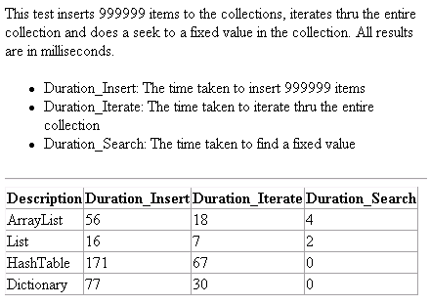
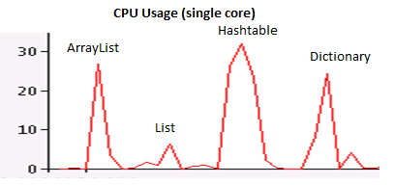
#3: Generics
So how slowly do the old collections perform compared to the newer ones?
The following url contains a sample test to check the performance
The results indicates that the generics class as compared to the older collections are
At least 2 times faster
Uses lesser cpu

Slide 30
#3: Custom Controls
What is the difference between User Controls, Custom Controls?
User Controls | Custom Controls
Stored in ascx and/or code behind | Stored in .cs or .vb files
Easy to create and use | More difficult to create and use
Uses normal web form programming model | Custom event handling and properties settings
Usually a collection of ASP.NET controls | Can customize HTML rendering
Usually found in single application scenario | Can be found anywhere
Basic skills required to maintain code | More advanced skills required to maintain code

Slide 31
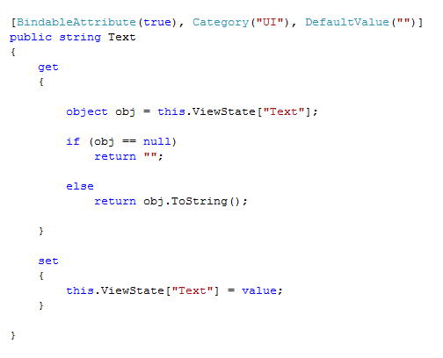
#3: Custom Controls - Properties
Creating properties for custom controls
Creating custom properties for controls is easy, just specify the getters and setters.
One thing to note is that if you want the property to remain on postback, you will need to store it somewhere e.g inside the ViewState

Slide 32
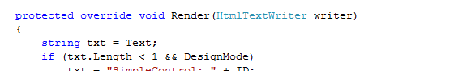
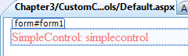
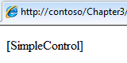
#3: Custom Controls - Rendering
Deciding how to render the custom control
This is essentially the most important part of the custom control, how to render it to the client.
You can either use the default rendering or else override it with your own custom rendering
Also notice the DesignMode property. This specifies if the current request is coming from design mode or from the actual display in a website. So depending on the value, you can render the control differently
Notes:
Show Chapter3\CustomControls\Default.aspx
http://localhost:12345/Chapter3/CustomControls/Default.aspx

Slide 33
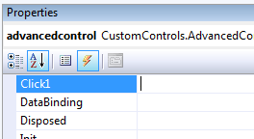
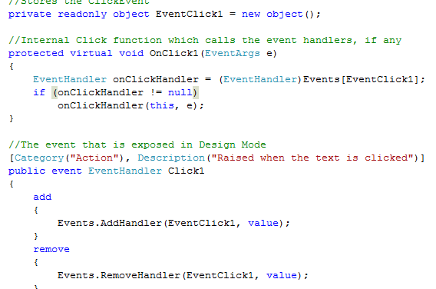
#3: Custom Controls – Custom Events
There are 3 parts to creating a custom event
Control must inherit IPostBack interface and implement its members
Create a readonly object containing the event
A function which will call this event
The event handler to expose to code
Notes:
Show App_Code\CustomControls\AdvancedControls.cs
http://localhost:12345/Chapter3/CustomControls/advanced.aspx

Slide 34
#3: Lab: Generics and Custom Controls
With great controls comes more requirements..
Now your boss wants a reusable and more useful real world grid
Lab Specifications:
Lab3.docx

Slide 35
#4: LINQ to SQL
LINQ To SQL
Overview of LINQ to SQL
Creating a LINQ TO SQL Relation
Working with LINQ To SQL Files
Lab: Creating a data aware web application

Slide 36
#4: LINQ to SQL
LINQ to SQL provides a runtime infrastructure for managing relational data as objects without losing the ability to query. Your application is free to manipulate the objects while LINQ to SQL stays in the background tracking your changes automatically

Slide 37
#4: LINQ to SQL – What does it do exactly
Converts your database tables and relations to .net classes
Perform database insert, update and delete operations directly on the .net classes and they will be reflected in the database
SQL like syntax inside .net codes
No need to worry about SQL injection
Automatically wraps all your database update and delete statements in a transaction
Caches previously requested data for faster access

Slide 38
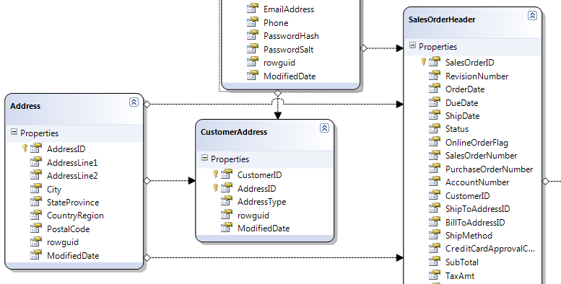
#4: LINQ to SQL – What does it do exactly
Automatic conversion from database tables to .net classes, complete with relations

Slide 39
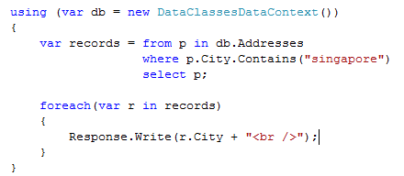

#4: LINQ to SQL – What does it do exactly
SQL like syntax for querying data
No need to worry about SQL injection, all updates/deletes wrapped in transactions

Slide 40
#4: LINQ to SQL – Creating LINQ to SQL Relation
Demo: LINQ To SQL in action
http://localhost:12345/Chapter4/demo/
Notes:
Show dbml file
Show linqsqldatasource
Show linq in code, join with normal list

Slide 41
#4: LINQ to SQL - Caveats
Works best with Microsoft SQL Server
Not as fast compared to normal SQL statements (can be reduced using compiled LINQ)
Need to update dbml when database structure is changed

Slide 42
#4: Lab – Creating a data aware web application
Now that you have proven yourself, other people ain’t happy, time for the noob hackers to appear!
MIS has reported SQL injection vulnerabilities in existing code
Lab Specifications:
Lab4.docx

Slide 43
Developing Advanced Microsoft ASP.NET Web Applications (C#)
Day #3

Slide 44
Outline
Day 3
Performance Programming
Overview of potential loopholes in ASP.NET Development
Looking at how to program better and faster
Lab: Optimizing your web application
Delegates and Extensions
What a delegate does
What are extensions
Lab: Using delegates and extensions in your code
Notes:
On day 2, we will tackle the more tricky topics of generics, custom controls and the new LINQ to SQL
And on day 3, I will teach you how to program better, and avoid bad and inefficient codes

Slide 45
#5: Performance Programming – Resource Utilization
Release resources once you are done with them
Cleaning up of resources used by your code is important to ensure that there are always sufficient resources to service your other requests. Ensure that you call the dispose() or close() function for all disposable objects.
One of the simplest way to do this is with the using keyword
using (SqlDataSource DS = new SqlDataSource())
{
DS.Select(DataSourceSelectArguments.Empty);
}
Notes:
Show sample of code with dispose and code without dispose

Slide 46
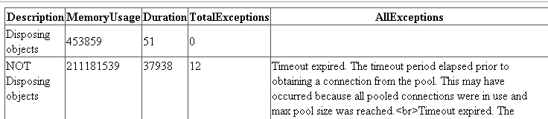
#5: Performance Programming – Resource Utilization
Demo of how not clearing up causes problem
This code opens a database connection, reads all data from the Address tables and closes the connections.
The only difference is that one set of codes disposes the objects whereas the other set of data does not.
Notice the vast difference in memory usage and runtime duration
http://localhost:12345/chapter5/disposingresources.aspx
Notes:
Show sample of code with dispose and code without dispose

Slide 47
#5: Performance Programming – Resource Utilization
String concatenation
String concatenation is a very expensive process, use StringBuilder instead, you will get a very great performance improvement.
Instead of doing
string S = “a”;
S = s + “b”;
Consider doing
System.Text.StringBuilder sb = new System.Text.StringBuilder(“a”);
sb.Append(“b");
sb.ToString();
Notes:
Show sample of code

Slide 48
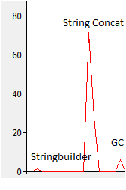
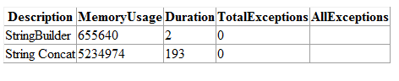
#5: Performance Programming – Resource Utilization
Lets see a sample of a comparison of a page which uses normal string concatenation vs using stringbuilder
http://localhost:12345/Chapter5/stringbuilder.aspx
Notes:
Show sample of code with dispose and code without dispose

Slide 49
#5: Performance Programming – Resource Utilization
String comparison
The tolower functions involve temporary allocations, which may be expensive during high load periods
Instead of doing
string1.toLower() == string2.toLower()
Consider doing
String.Compare (string strA, string strB, bool ignoreCase);
String.Compare(string1, string2, true);
Notes:
Show sample of code

Slide 50
#5: Performance Programming - Performance
Multiple Property Calls
If you frequently call a property, consider storing it in a variable. Property calls are expensive compared to a lookup for a variable. As an example just look at the following 2 examples, the second sample where the count() property is called during each iteration dramatically increases the runtime by at least threefolds.
//Storing the count in a variable and using the variable in the forloop
int ttl = list.Count();
for (int j = 0; j < ttl; j++)
string y = list[j];
//Referencing the count property each time the forloop is run
for (int j = 0; j < list.count(); j++)
string y = list[j];

Slide 51
#5: Performance Programming - Performance
For Loops
There are many types of for loops available in .NET, e.g for each, for loop, List.ForEach
Although using ForEach is good as it gives strong typing, it is actually slower than using a normal for loop, but only if the for loop condition refers to a direct primitive value (e.g integer of value 10). If for example you are iterating thru a List<> object, the fastest code will be

Slide 52
#5: Performance Programming - Performance
int ttl = list.Count();
for (int j = 0; j < ttl; j++)
string y = list[j];
followed by
foreach (string s in list)
string y = s;
And last place is
for (int j = 0; j < list.count(); j++)
string y = list[j];
If you are using the generics list class, it comes with an additional ForEach function which gives a much better performance compared to using the methods listed above.
list.ForEach(delegate(string s) { string y = s; });
Notes:
Demo and explain why the part is slow

Slide 53
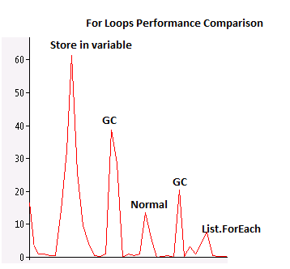
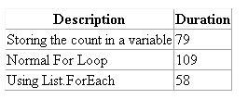
#5: Performance Programming – Resource Utilization
Demo of differences between the various methods
This test creates a list of 9,999,999 elements and does a loop thru all its elements
http://localhost:12345/Chapter5/forloops.aspx
Speed wise, storing in a variable is slightly faster than using a normal for loop, although CPU usage is higher. The best performance comes from using the List.ForEach method, which is almost twice as quick as a normal for loop and uses much lesser CPU
Notes:
Show sample of code with dispose and code without dispose

Slide 54
#5: Performance Programming - Performance
Exit Conditions
If you have multiple exit conditions, put them when it is first possible to check and also put the one most likely to happen right on top. This reduces the amount of checks needed to exit, which can give you a performance improvement.
So instead of
bool isValid(string UserID, string Password)
{
int result = executesql("select count(*) from users where userid=... and password=...");
if (result == 1)
return true;
}

Slide 55
#5: Performance Programming - Performance
So instead of
bool isValid(string UserID, string Password)
{
int result = executesql("select count(*) from users where userid=... and password=...");
if (result == 1)
return true;
}
Consider the following
bool isValid(string UserID, string Password)
{
//ensure UserID contains something
if (UserID == null || UserID.Length < 1) return false;
//ensure password contains something
if (Password == null || Password.Length < 1) return false;
int result = executesql("select count(*) from users where userid=... and password=...");
if (result == 1)
return true;
This reduces the expensive db call if userid or password is empty.

Slide 56
#5: Performance Programming – Web Apps Performance
Application State
Each time a web application starts, it creates an application state dictionary which you can use to store values pertaining to the application. For example you can store the application name inside application state for access by your aspx pages. Note that items stored in application exist for the entire duration when the application is available. As long as you initialize the value, you do not really need to check when accessing the parameter to see if it is null.
e.g inside global.asax
void Application_Start(object sender, EventArgs e) { Application["LastReload"] = DateTime.Now; }
inside your aspx pages
Response.Write((Application["LastReload"] as DateTime).ToString("dd MM yy");

Slide 57
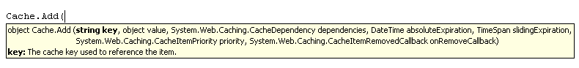
#5: Performance Programming – Web Apps Performance
Caching
If you have commonly used data which does not change often, you can consider storing it in cache to improve performance. Instead of calling the db to get a list of categories, call it once and store it into cache. The next time you need this list, get it from the cache instead. Remember though, you need to check whether the item returned from cache is null
object obj = Cache["key"];
if (obj == null)
{
//get the data from database
}
else
{
return (obj as List<string);
}

Slide 58
#5: Performance Programming – Web Apps Performance
Session State
Use session state to store user specific properties. If you have no need for sessionstate, remember to turn it off in web.config using the following code
<sessionState mode="Off" />
As SessionState is the state which is usually kept the shortest, always check to ensure that the value returned is checked for null, this ensures that the NullValueException which can potentially be raised is not triggered.
object obj = Session["key"];
if (obj == null)
{
//get the data from database
}
else
{
return (obj as List<string);
}

Slide 59
#5: Performance Programming – Web Apps Performance
ViewState
By default every page will have viewstate enabled. This will increase your page size along with serialization and deserialization costs. These costs can become very large especially when you have gridviews or datagrids in your page.
You should disable viewstate on the page if the page is an output page and does not do any further processing.
Additionally if the control does not handle any event, does not have any data bound values, or the data is constantly refreshed on postback, you can disable the viewstate for the control.
e.g you have a label which displays the userid with the value always refreshed on page load. In this case there is no need for viewstate.
<asp:Label ID="lbl" runat="server" />
and inside the page cs page
protected void Page_Load(object sender, EventArgs e)
{
lbl.Text = User.Identity.Name;
Notes:
Show sample of how large viewstate can get

Slide 60
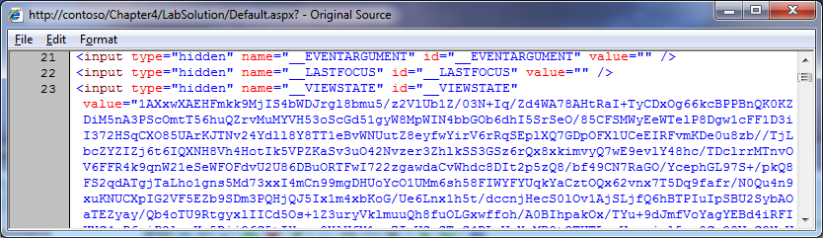
#5: Performance Programming – Web Apps Performance
ViewState
To have an idea how big viewstate can get, goto your lab 4 solution and view the source code. Notice how a big portion of the page is used for the hidden parameter _VIEWSTATE
Notes:
Show sample of how large viewstate can get

Slide 61
#5: Performance Programming – Web Apps Performance
Solution: Move ViewState to Session (Page State Persistor)
How?
Add the following line to your page
protected override PageStatePersister PageStatePersister{get{return new SessionPageStatePersister(this);}}
http://localhost:12345/chapter5/sessionviewstate.aspx
Notice how the viewstate is smaller now, but its not totally gone, why?
Notes:
Show sample of how large viewstate can get

Slide 62
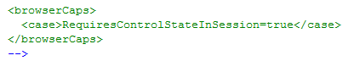
#5: Performance Programming – Web Apps Performance
ControlState
The viewstate parameter also stores the control state
So we need to move the controlstate to session too!
Add the following to system.web section of web.config
Refresh, and view source now
Notes:
Show sample of how large viewstate can get

Slide 63
#5: Performance Programming – Web Apps Performance
 | Application State | Cache | ViewState | Session
Duration | Lifetime of IIS process | Lifetime of IIS process | Lifetime of Page (stored in a hidden input parameter in the html or session state) | Lifetime of Session (default is 20 minutes)
Usage | Stores application wide settings. Implemented for backward compatibility, use of cache recommended | Can be used to store anything. Best option to store application wide settings | Stores data related to the page, have to be carefully managed so that it does not become unmanagable | Stores data related to the session, fastest performance of the lot
Dependencies | None | Other Cache Items, File | None | None
Expirations | None | Absolute, Sliding | None | None

Slide 64
#5: Performance Programming – Syntactic sugar
Expression Trees
Other than using LINQ like statements for SQL, you can also use them in daily normal coding. So instead of doing a for loop to find for a specific item, you can use LINQ to do it for you

Slide 65
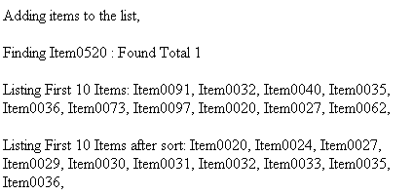
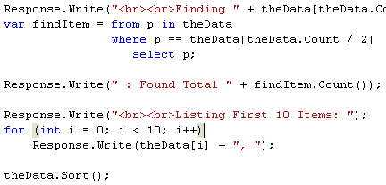
#5: Performance Programming – Expression Trees
The sample code tries to find a specific item in the list and display the total number of items inside. After that it sorts the list and list the items in order
Notes:
Show sample of code with dispose and code without dispose

Slide 66
#5: Performance Programming – Compiled LINQ
Previously I mentioned that LINQ is slow. This is because at every run the compiler needs to figure out what the expression means and generate the appropriate code
from U in dc.Users where U.UserID == userid select U
To solve this issue, you can create a compiled LINQ reference and call the function instead (think delegates)
public static Func<DataContext, string, IQueryable<Address>> CQ_GetAddressRecord = CompiledQuery.Compile<DataContext, string, IQueryable<Address>>((dc, Address) =>
from U in dc.Addresses
where U.Address == Address
select U
);

Slide 67
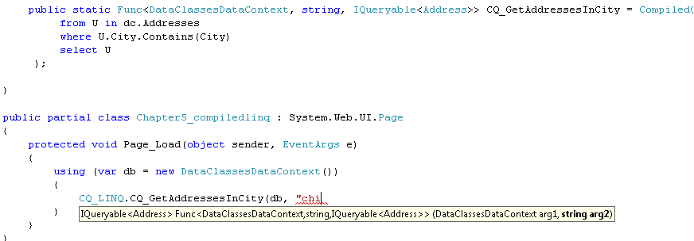
#5: Performance Programming – Compiled LINQ
This page shows a sample of a compiled query and binding the resulting data to a gridview
http://localhost:12345/Chapter5/compiledlinq.aspx
One of the important things to note is that compiled linq returns a READONLY result, you do not have the ability to edit and save the changes

Slide 68
#5: Lab

Slide 69
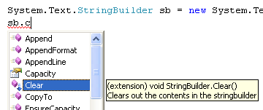
#6: Extensions
Extensions
There are always times when we want to add a new function to an existing class which we do not have the code, and it is troublesome to create a new class just to add in this new function. What you can do is use extensions to add functions to existing classes.
e.g to add a Clear function to the StringBuilder class I can use thefollowing
public static class StringBuilderExtensions{
public static void Clear(this StringBuilder sb){
sb.Remove(0, sb.Length);
}}

Slide 70
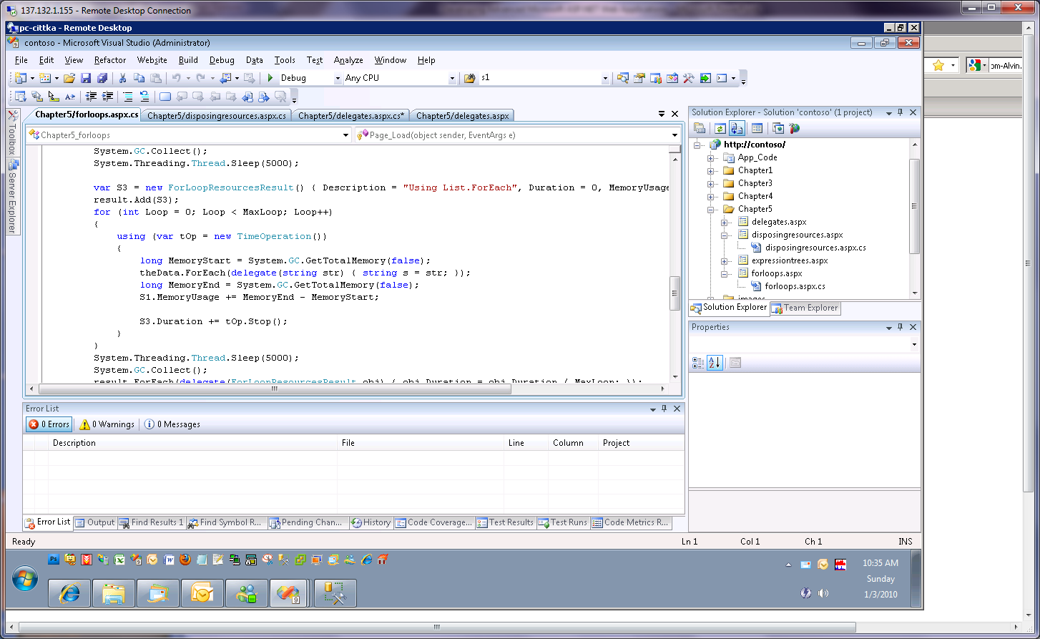
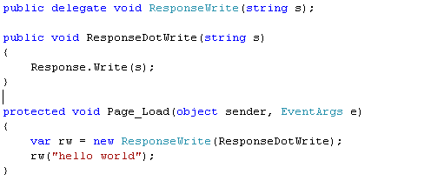
#6 - Delegates
Delegates are references to functions. This is usually used to create dynamic one time use functions (think about list.foreach)
or else provide an easy way to link to a function

Slide 71
#6: Lab
Putting it all together

Slide 72
#6 – Parallel Programming - What is it all about?
Parallel Programming is..

Slide 73
#6: Parallel Programming – When do we use it?

